Slide 1
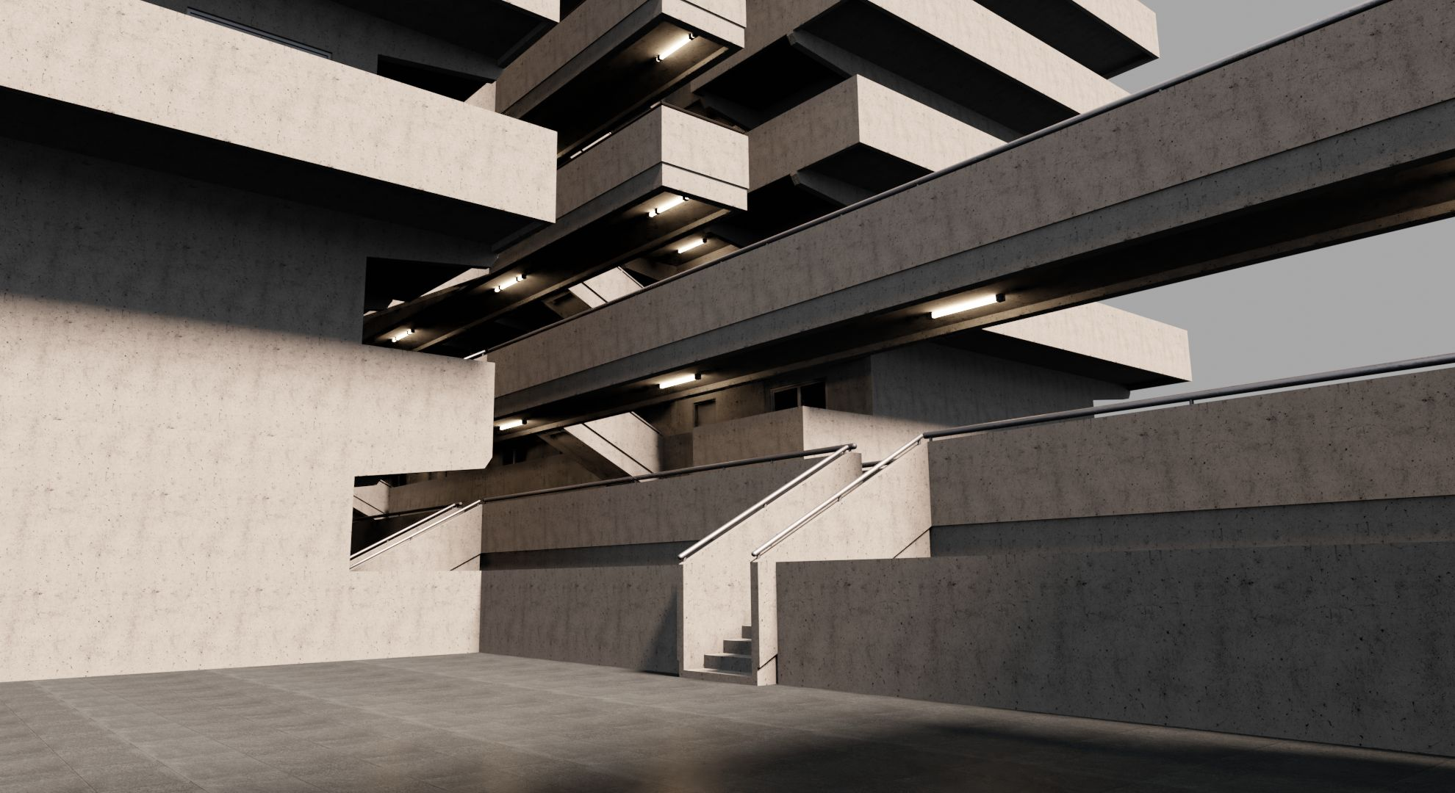
Concrete Analysis
Predicting Failure in Fibre-Reinforced Concrete
Insert Names Here PLS

Slide 2
The Goal
It is bad when structures collapse.
Fibre Reinforced Concrete boasts greater durability, however the makeup of fibres plays a key role.
The Aim is to predict the durability of fibre-reinforced concrete based on fibre parameters.

Slide 3
The Data
Sourced from a series of experimental trials by the SIKA
Contains 1440 observations and 10 variables, 7 of which are used as independent variables while the remaining 3 are dependent

Slide 4
The Goal – 2 Level Predictive Modeling
1. Level Hypothesis: IFSS
Interfacial sheer strength (IFSS) can be sufficiently predicted through the profile area, fibre length, avg. fibre circumference and Titer.
2. Level Hypothesis: Minibeam energy absorption
IFSS and fibre tenacity can be used to sufficiently predict Minibeam energy absorption and subsequently failure.

Slide 5
The Goal – Flowchart 2 Level Predictive Modeling
1. Level
2. Level
W_Sm
calculate
Profile Area
W_q
Fibre length
predict
IFSS
Titer
predict
Minibeam energy absorption
calculate
Failure mode
Fibre Tenacity
Avg. circumference

Slide 6
The Catch
In the Field, it is common that not all parameters are known
To be applicable to the real-world, this issue has to be dealt with
Prediction of missing parameters is often not possible
Solution:
Create multiple models and figure out which works best for which missing data
Incorporate a decision-tree approach were the most reliable model is chosen for the situation

Slide 7
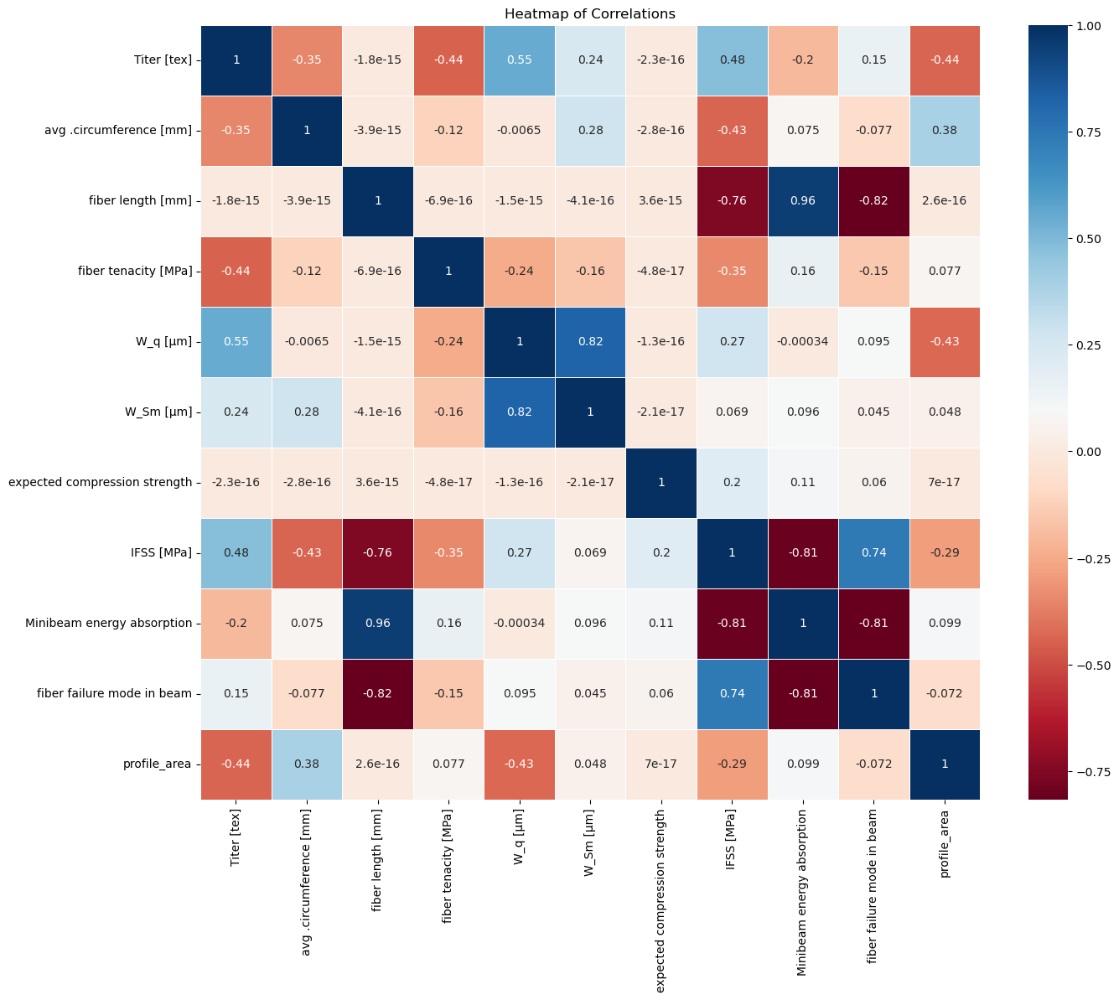
The EDA
No significant outliers found with z-scores > 3 or <-3
Some significant correlations found through PearsonsR
Some unexpected correlations with fibre length
Not a perfect correlation between failure mode and energy absorption

Slide 8
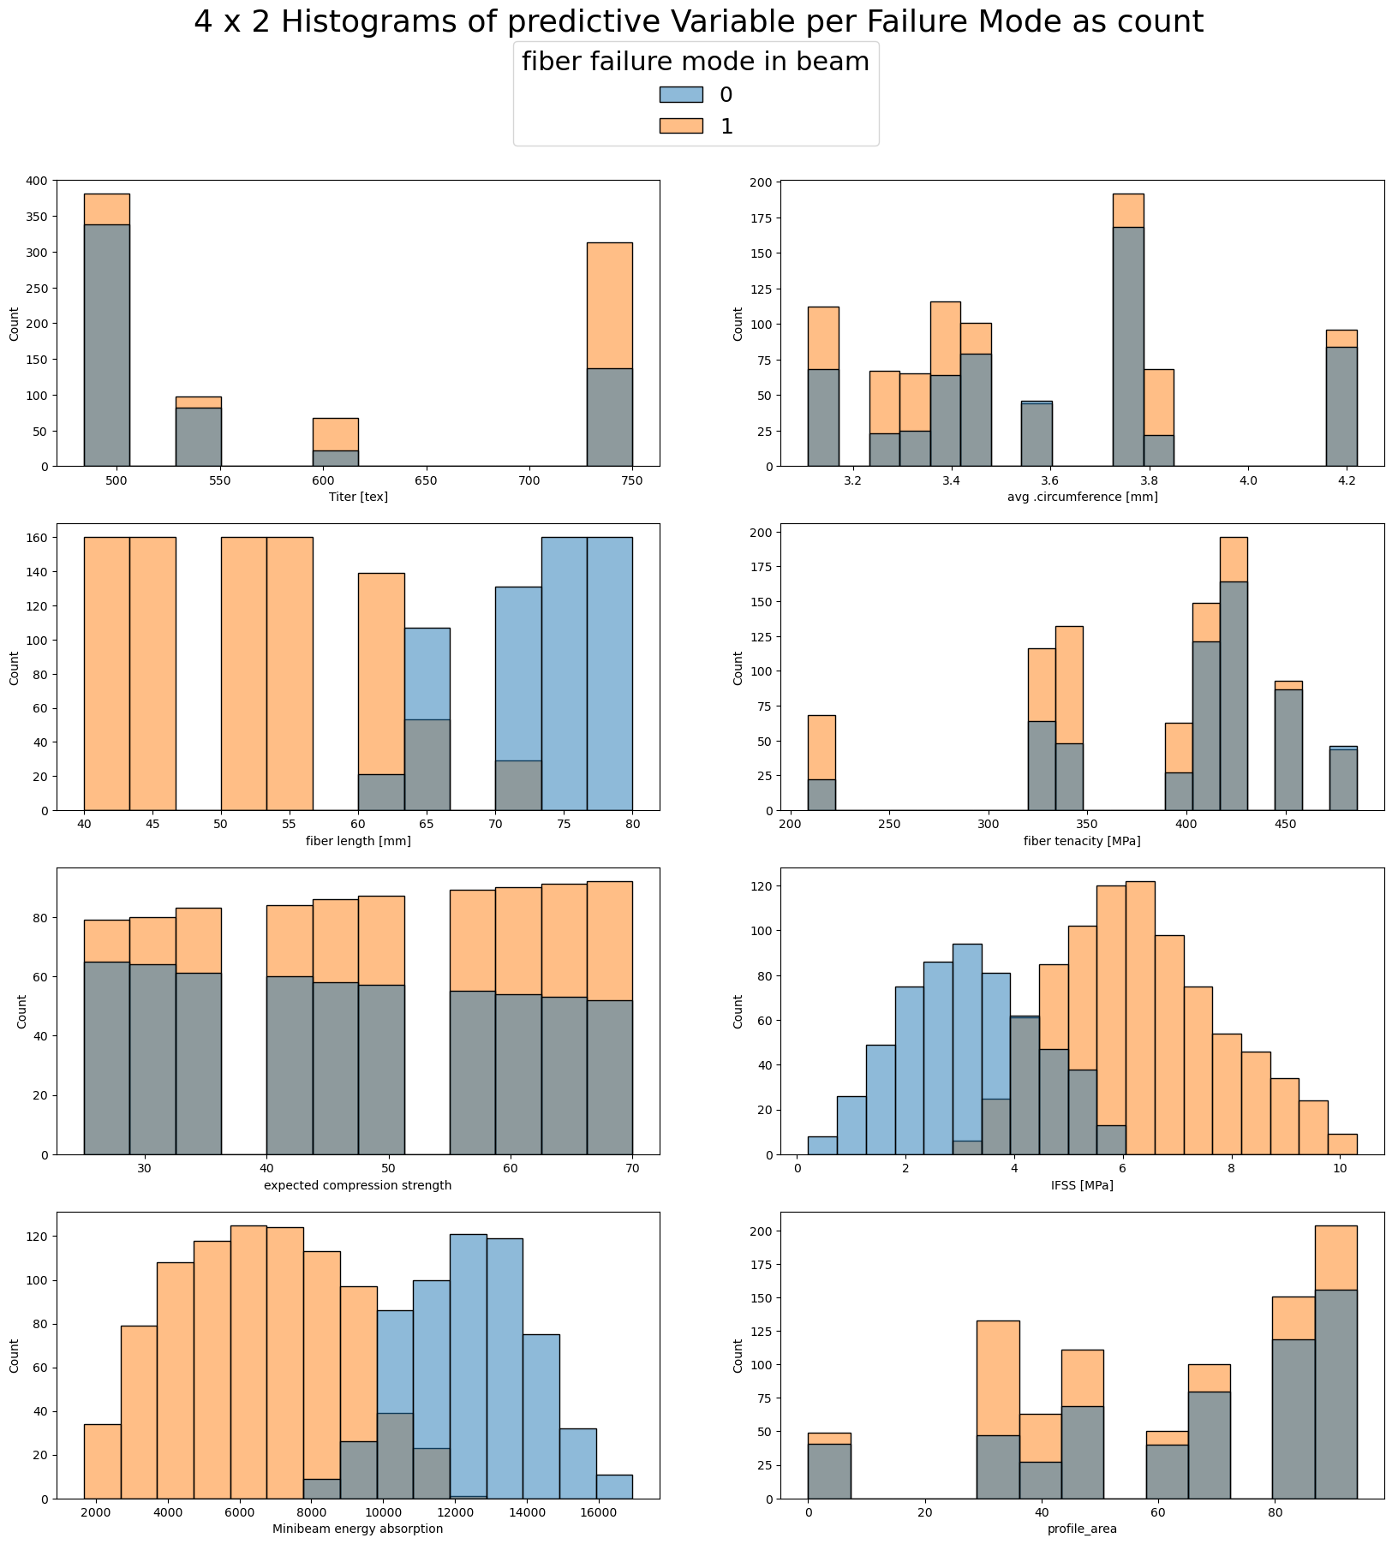
The EDA
No significant outliers found with z-scores > 3 or <-3
Some significant correlations found through PearsonsR
Some unexpected correlations with fibre length
Not a perfect correlation between failure mode and energy absorption

Slide 9
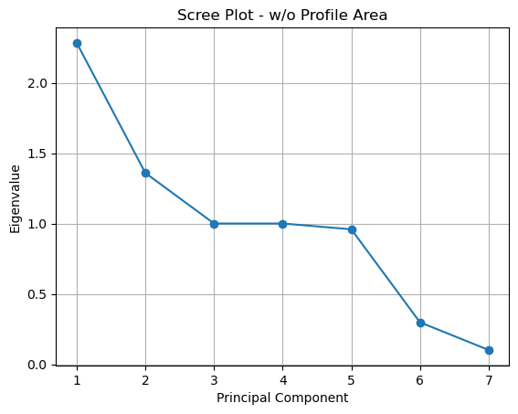
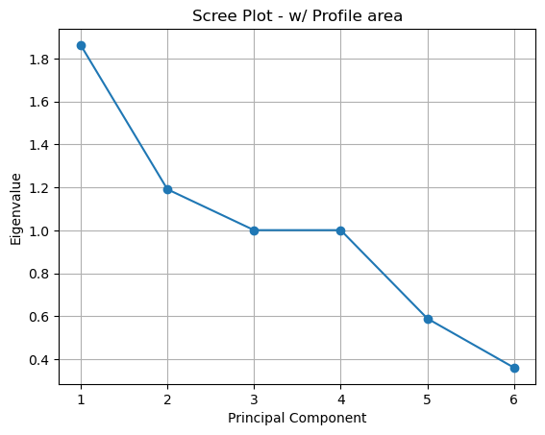
The PCA
Suggests dimensionality reduction to 4 or 5 principal components
Due to the relatively small size of the data and the ease of computing, we chose to continue to utilize the full dataset w/o Profile Area to increase prediction quality

Slide 10
The Models
Suggests dimensionality reduction to 4 or 5 principal components
Due to the relatively small size of the data and the ease of computing, we chose to continue to utilize the full dataset w/o Profile Area to increase prediction quality

